Slide 1
CTI League
Disinformation
2020-05-20
TheHive & Cortex

Slide 2

TheHive & Cortex
Incident Response Platform + SOAR
Enrichment via Cortex modules
MISP Integration
Dashboards
KPIs
Task Tracking
Collaborative
Scalable
Excellent API + Webhooks

Slide 3
TheHive for Disinformation?
How are we going to use TheHive?
Case tracking
Task tracking
Indicators of Disinformation (IOD) correlation*
IOD enrichment
Cortex Analyzers
Dashboards

Slide 4
TheHive for Disinformation?
How are we not going to use TheHive?
Data dumpster
Complex Objects*
Tweets + Metadata
Facebook Pages, Narratives, etc
* coming in TheHive 4.1+
Authoritative Record/Source of Truth
MISP will do that

Slide 5
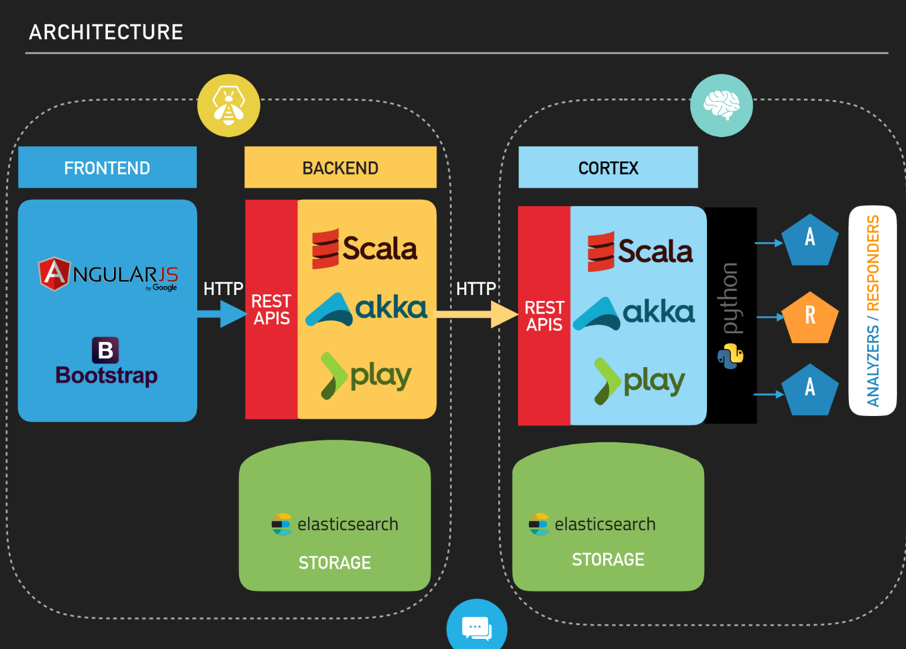
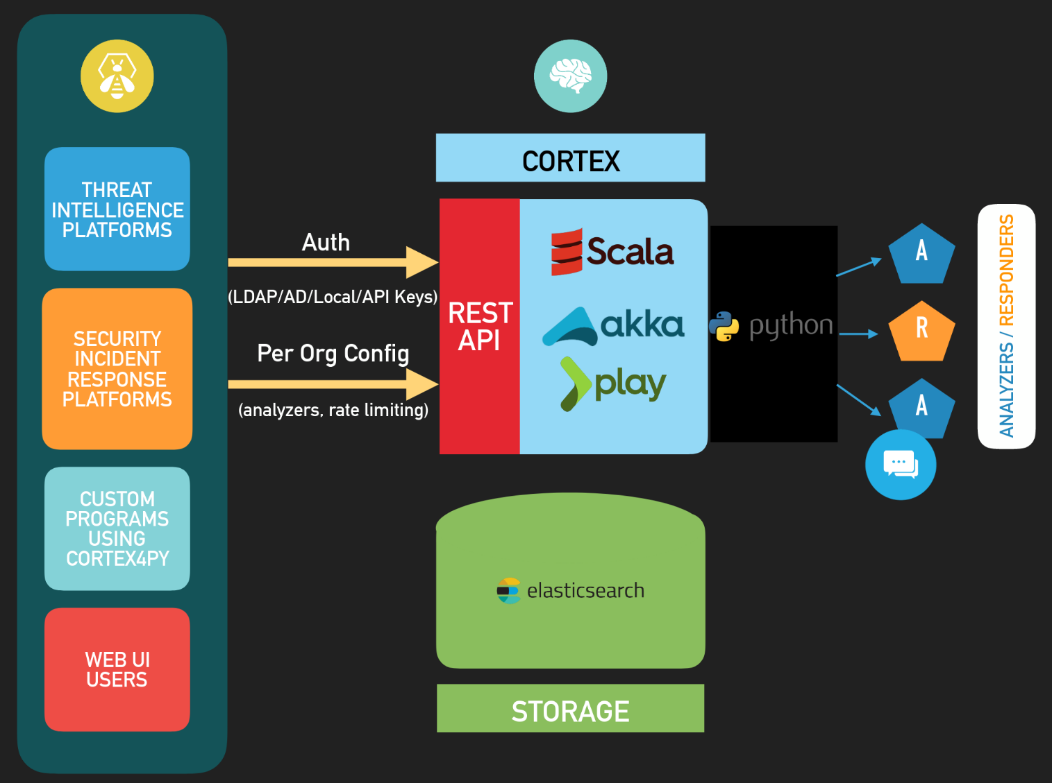
Architecture
BSides Lisbon 2018 - Saâd Kadhi

Slide 6
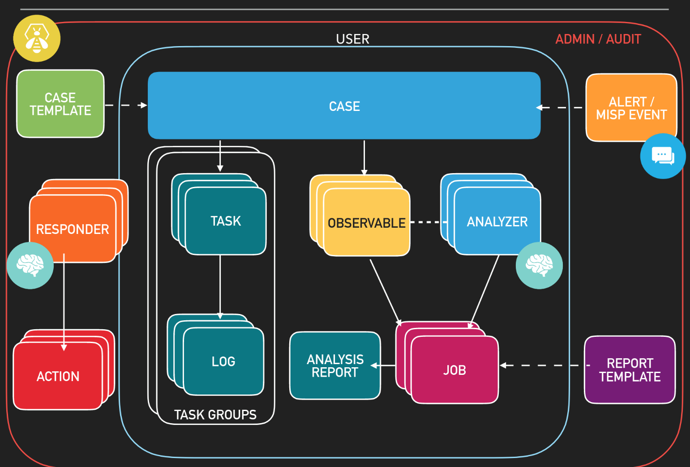
Workflow
BSides Lisbon 2018 - Saâd Kadhi

Slide 7
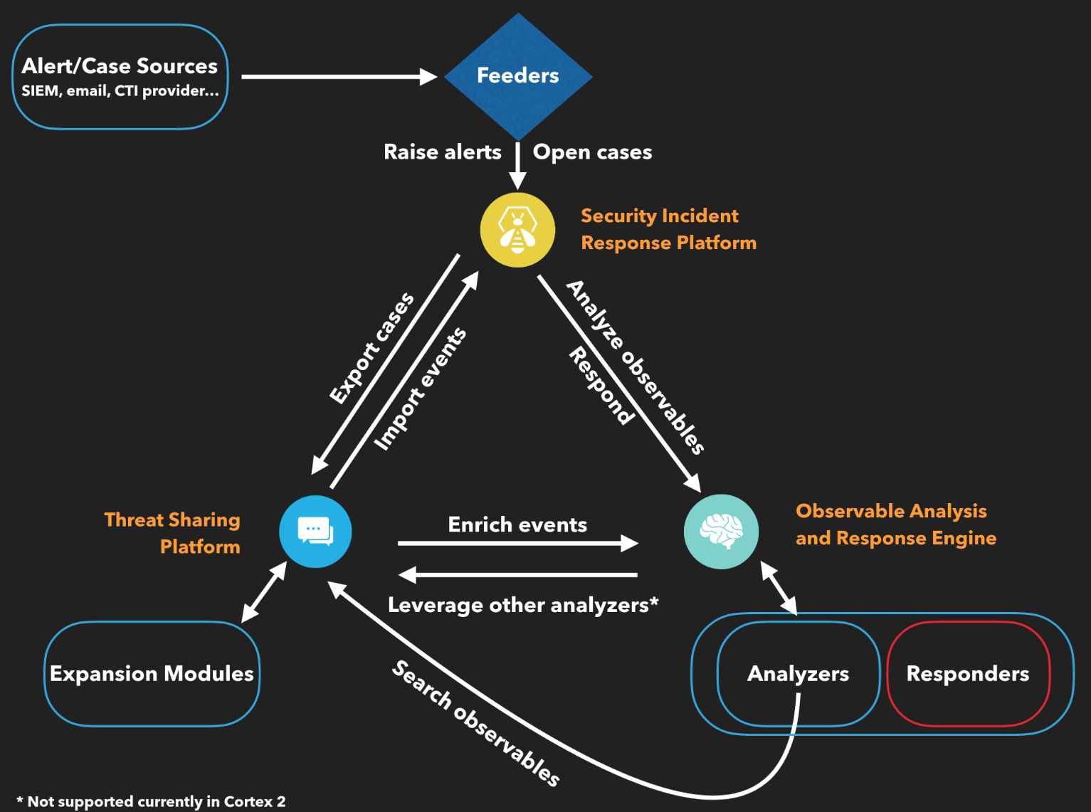
Integration
BSides Lisbon 2018 - Saâd Kadhi

Slide 8
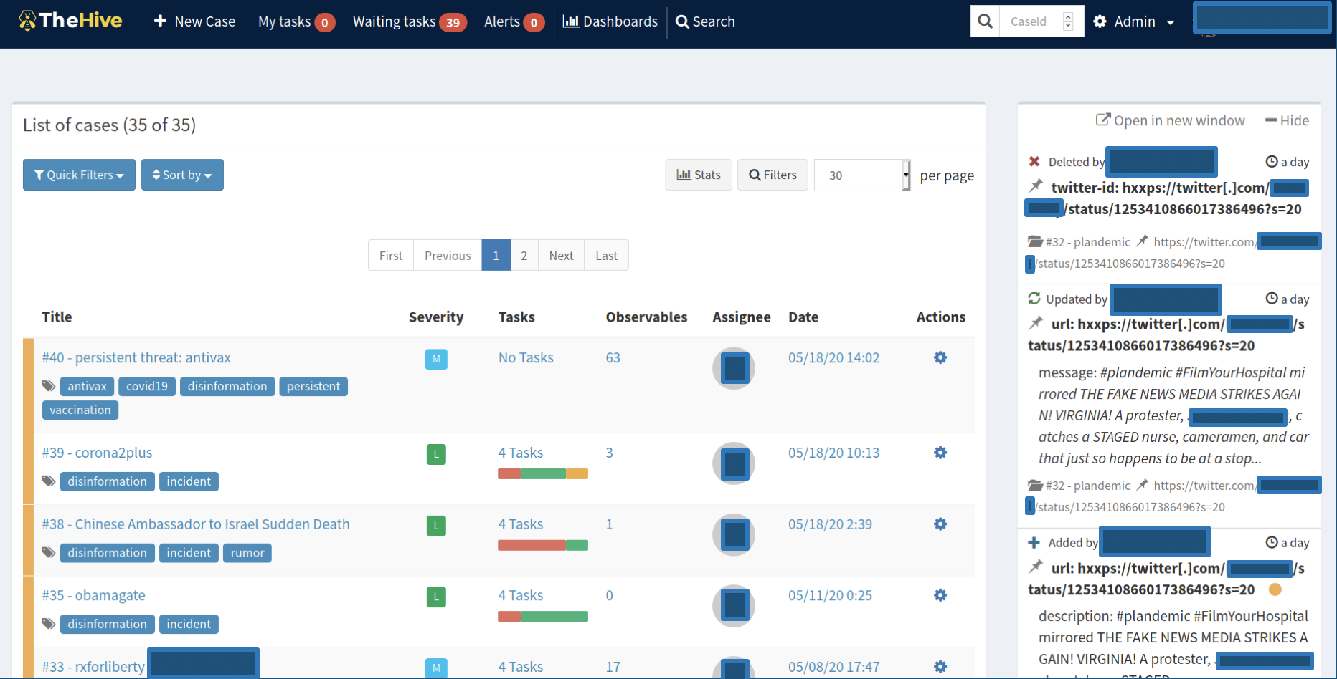
Cases

Slide 9
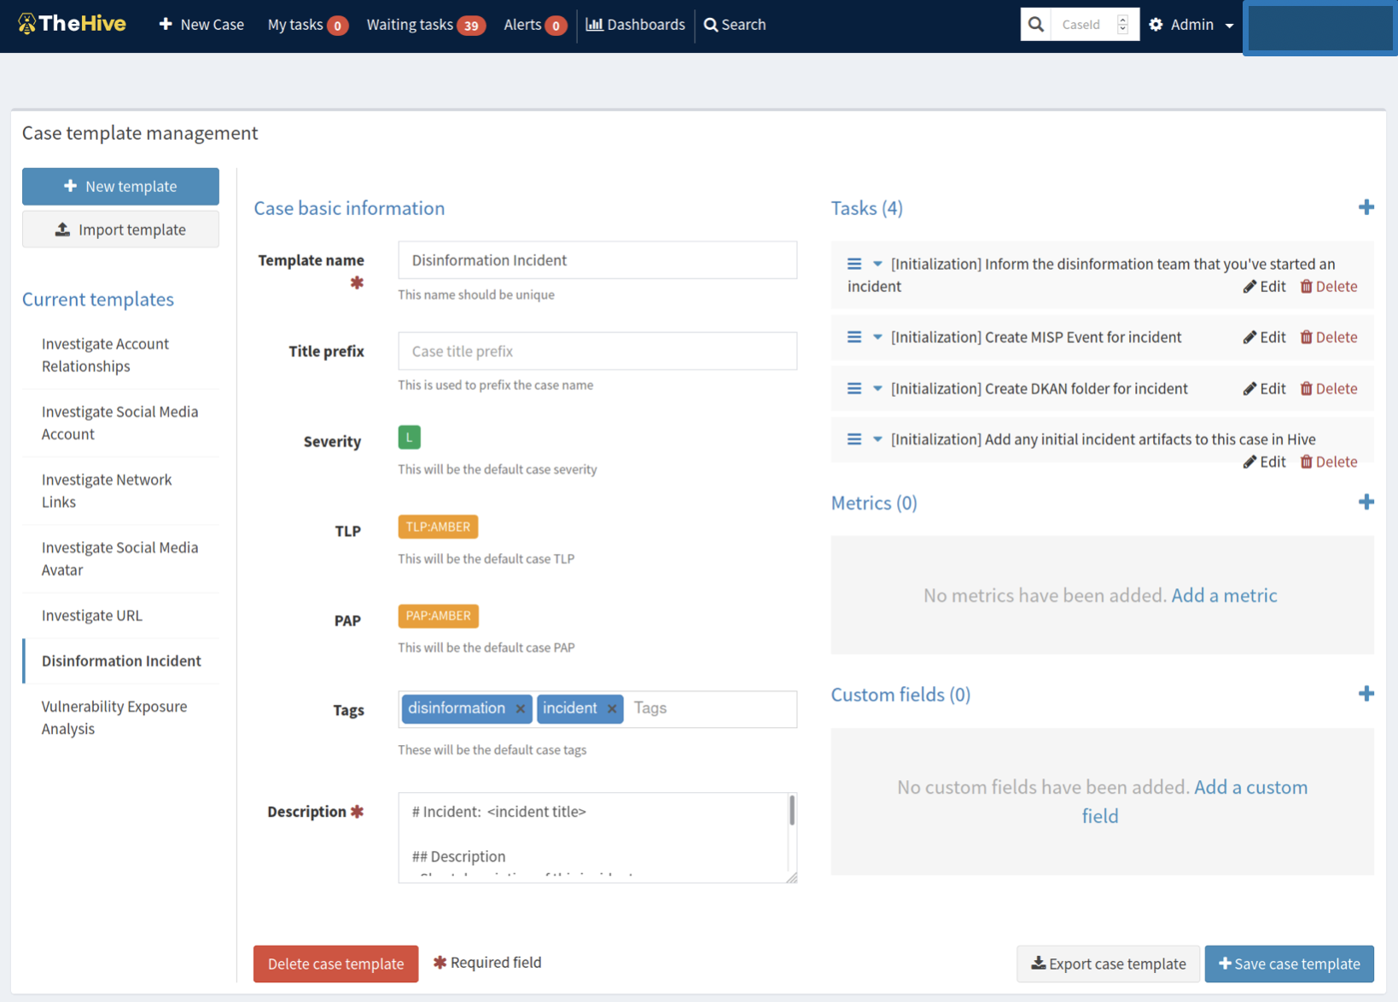
Cases Templates

Slide 10
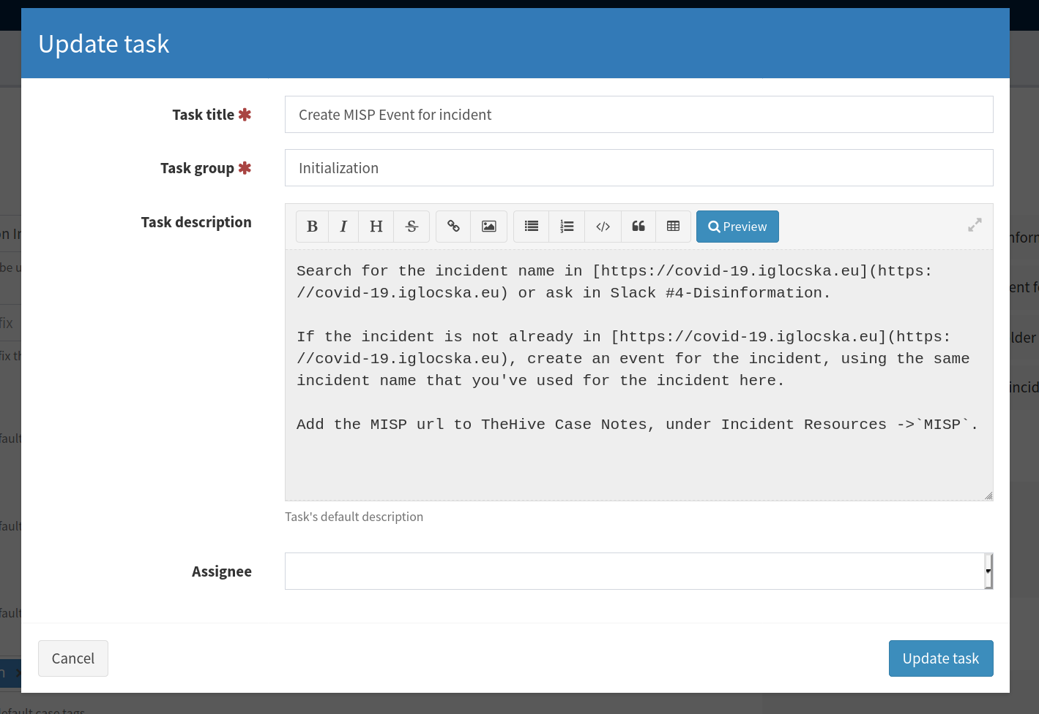
Cases Templates - Tasks

Slide 11
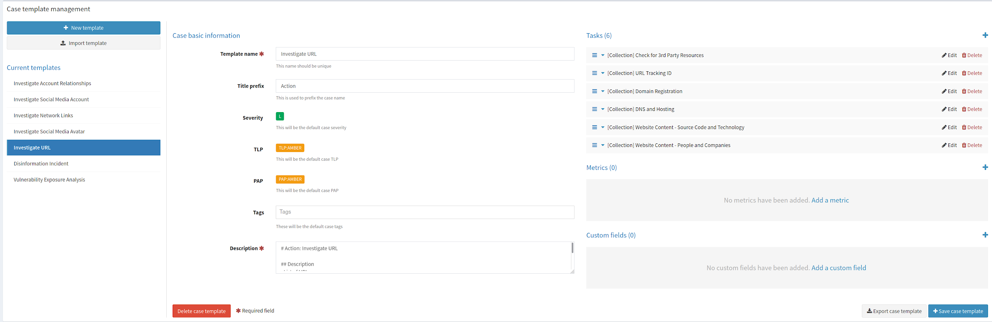
Cases Templates - Workflows

Slide 12
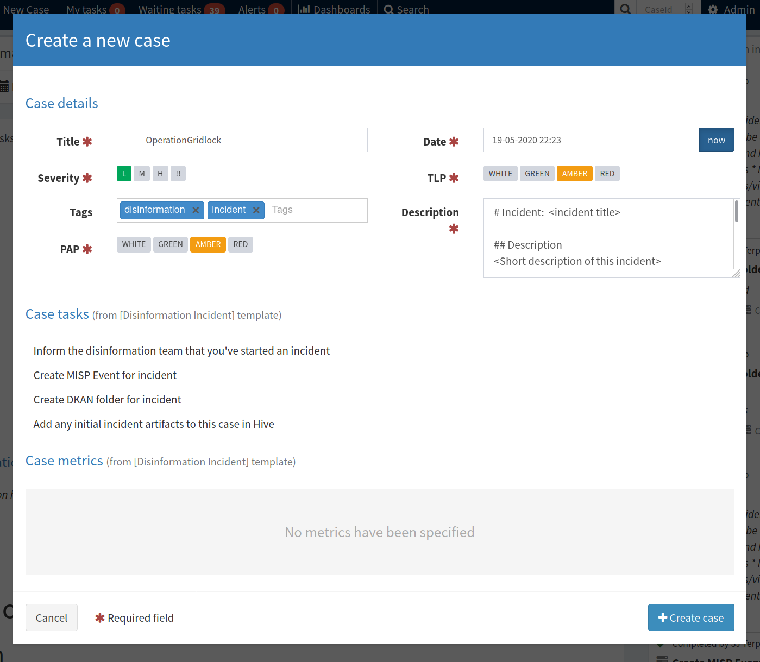
Create a Case

Slide 13
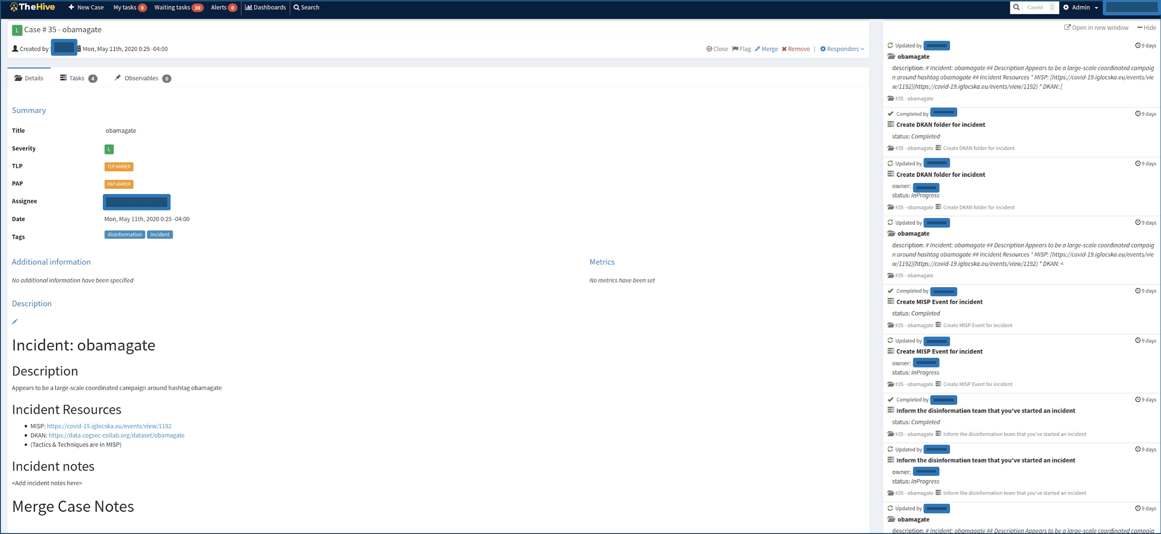
Case - Summary

Slide 14
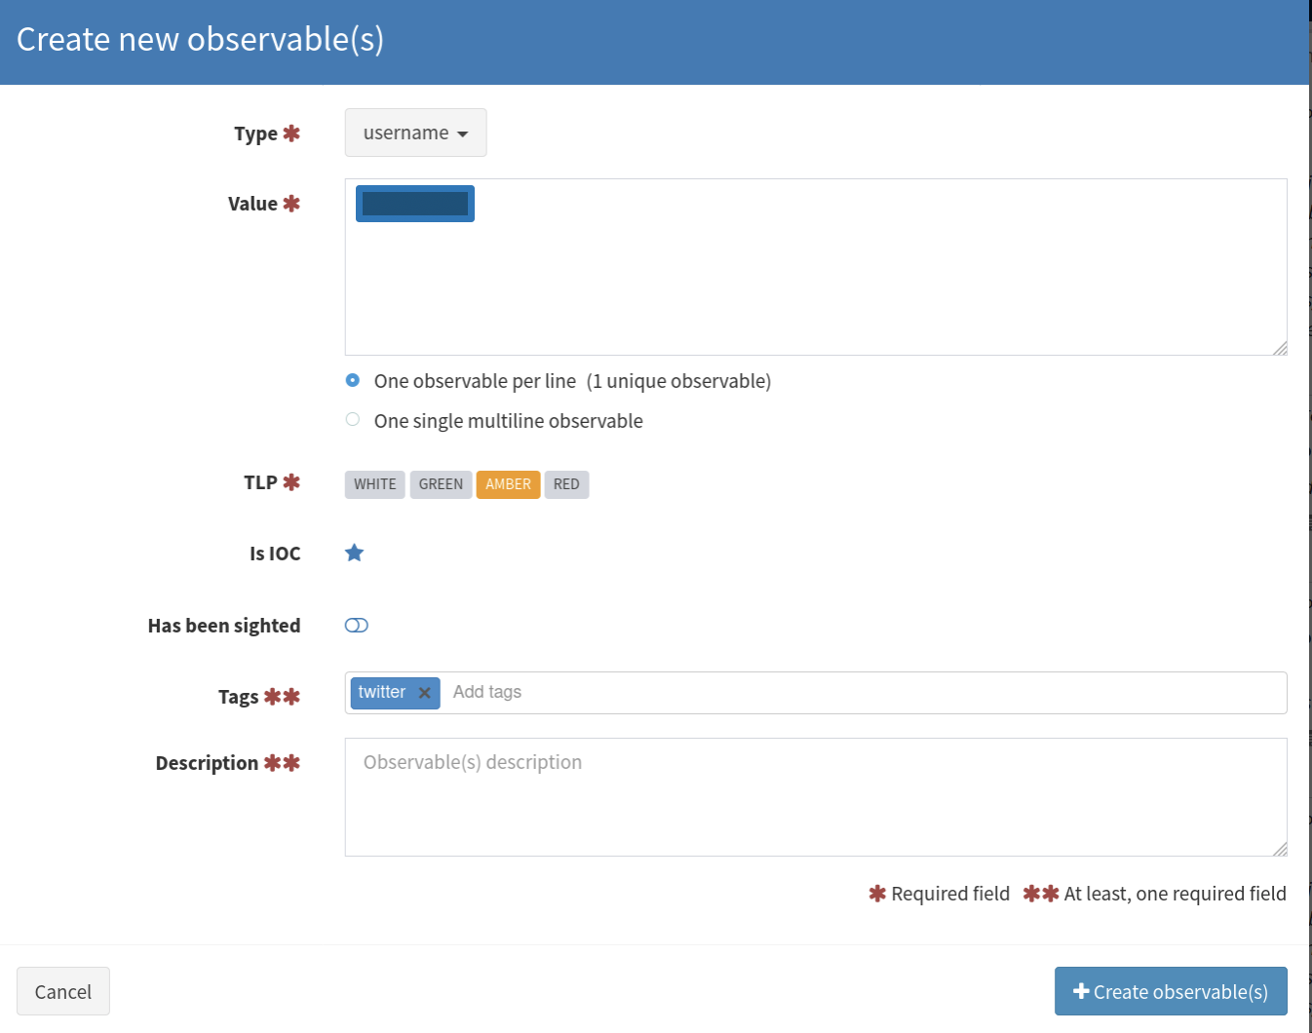
Add Observables (IODs)

Slide 15
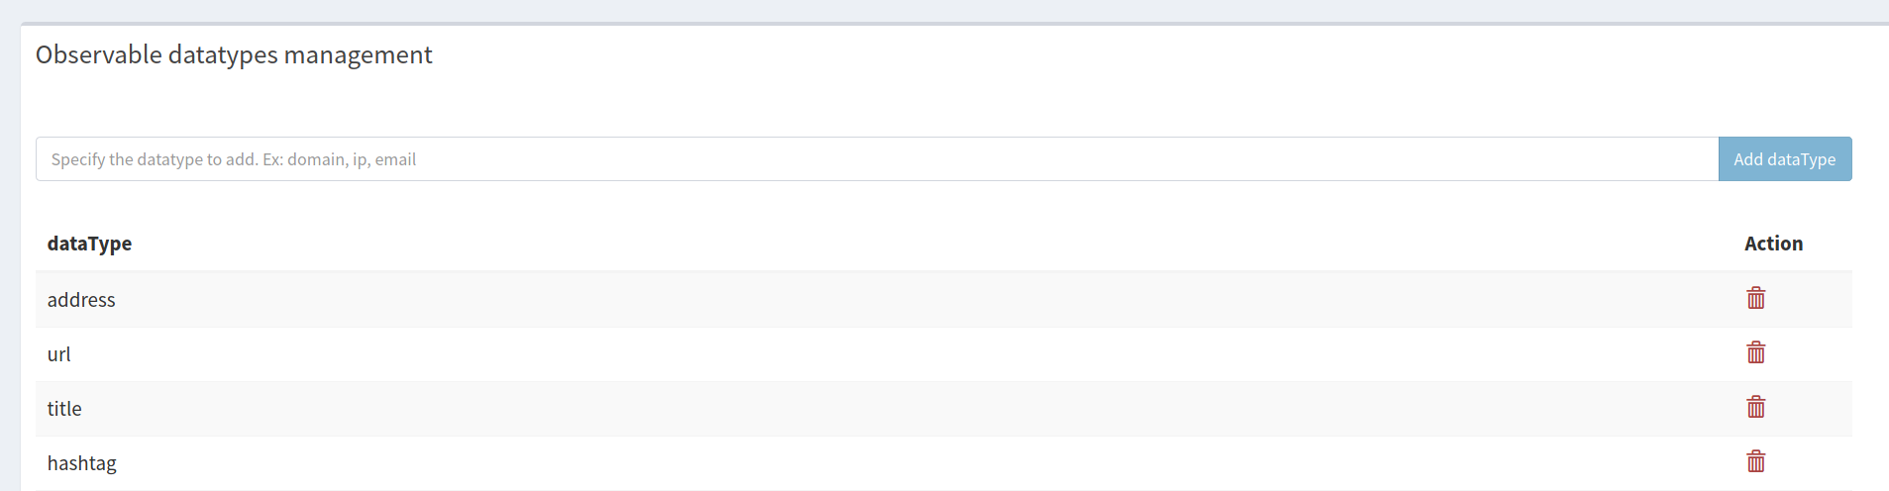
Observables Types

Slide 16
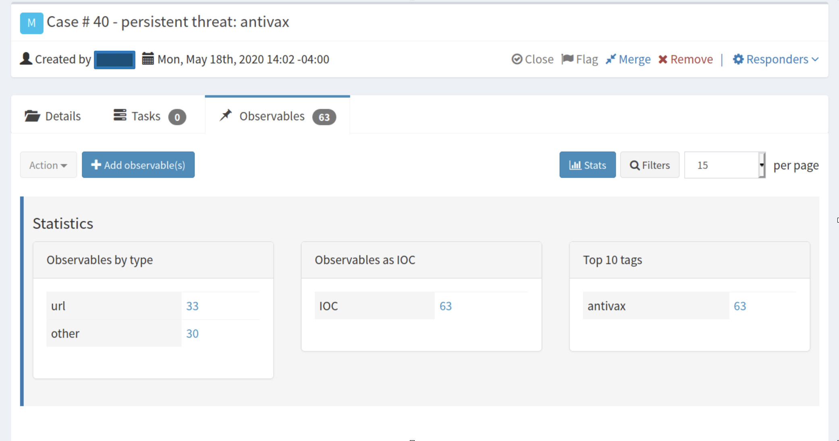
Observables Stats

Slide 17
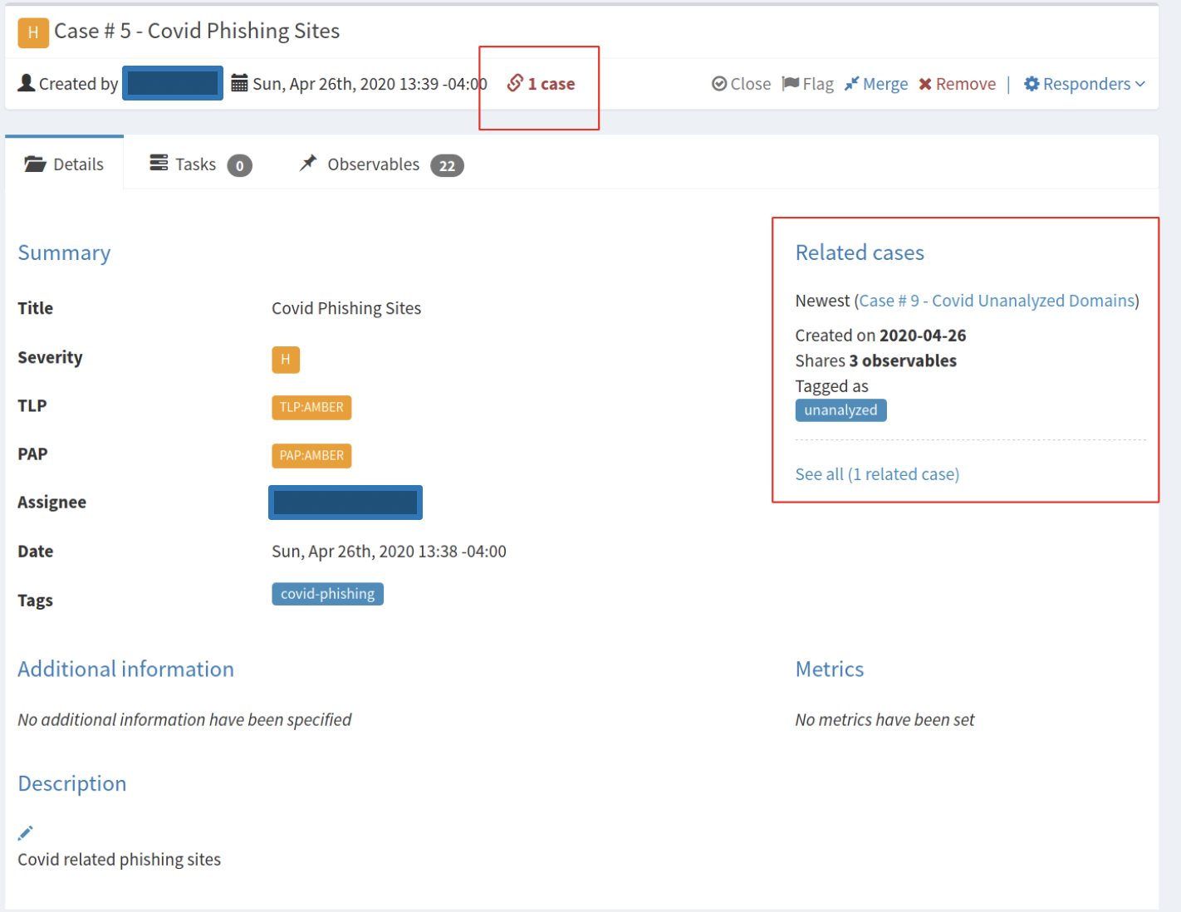
Correlation

Slide 18
Disinformation Incident Task Lists
Information operations are complex ...
Time
Resources
Infrastructure
Execution
… and multidisciplinary...
Classic infosec stuff is just the beginning
… but we must handle all edge cases
We should be able to import sets of tasks to do the thing as needed
We won’t know what we need in advance
Some sets of things will be very large/complicated

Slide 19
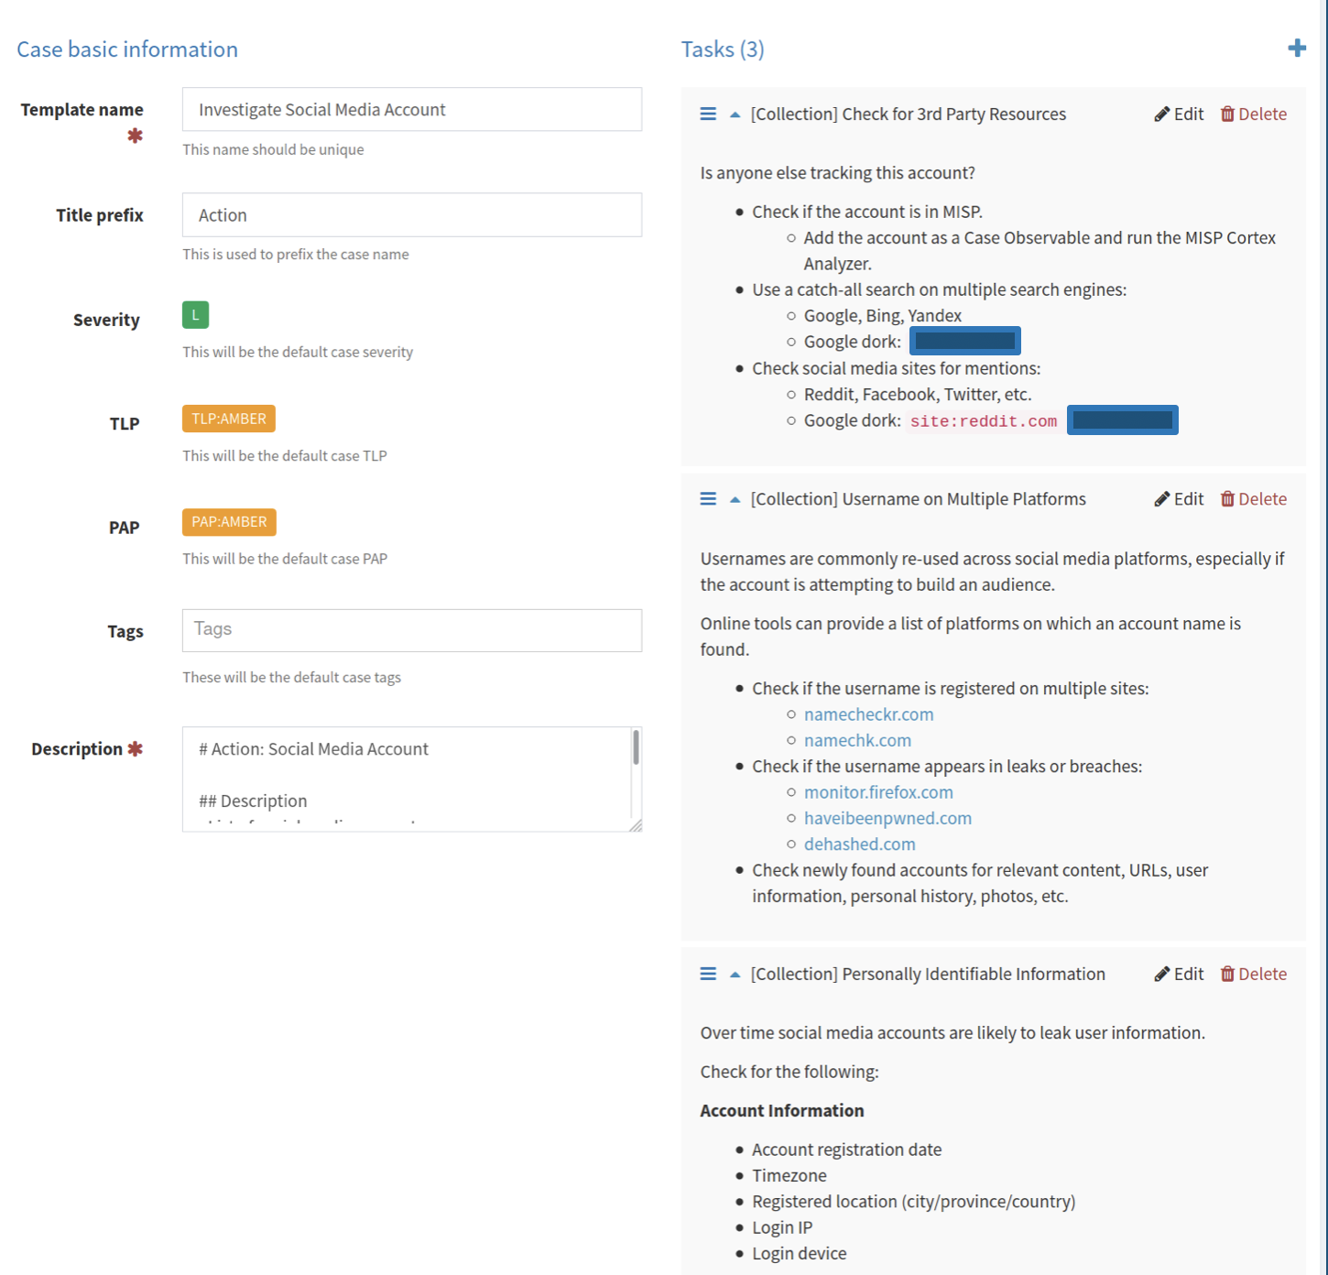
Case Template
Playbooks
Sets of response actions

Slide 20
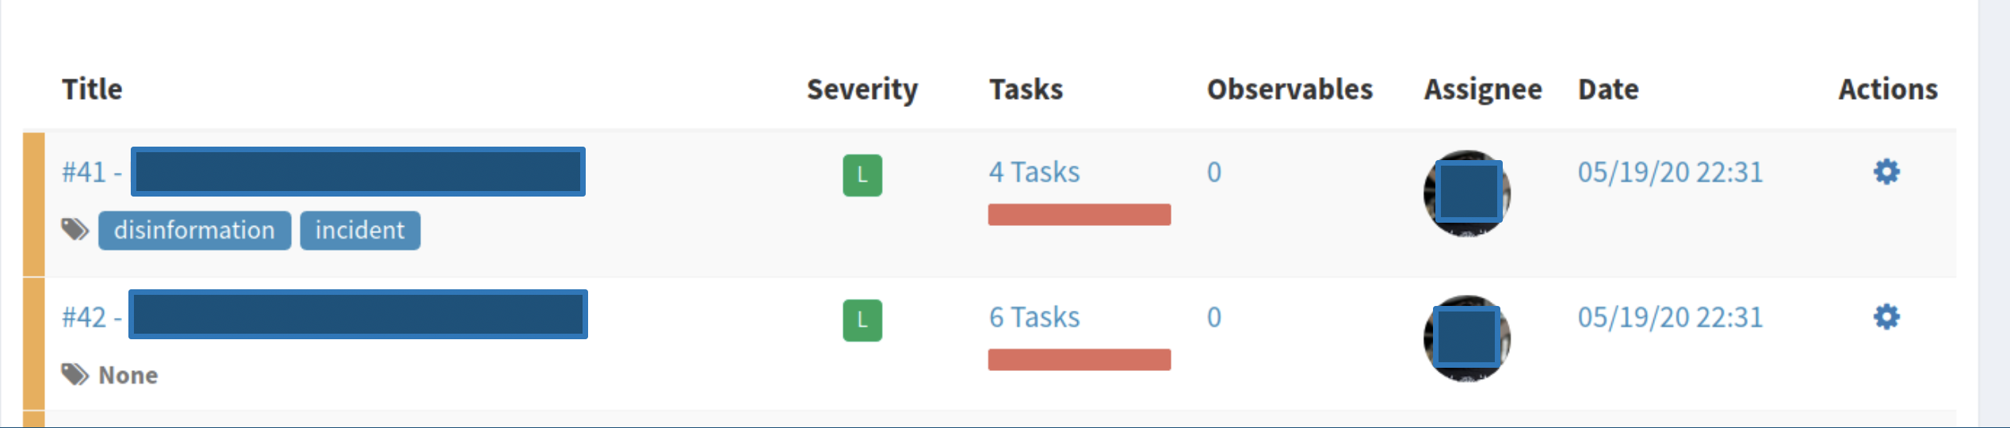
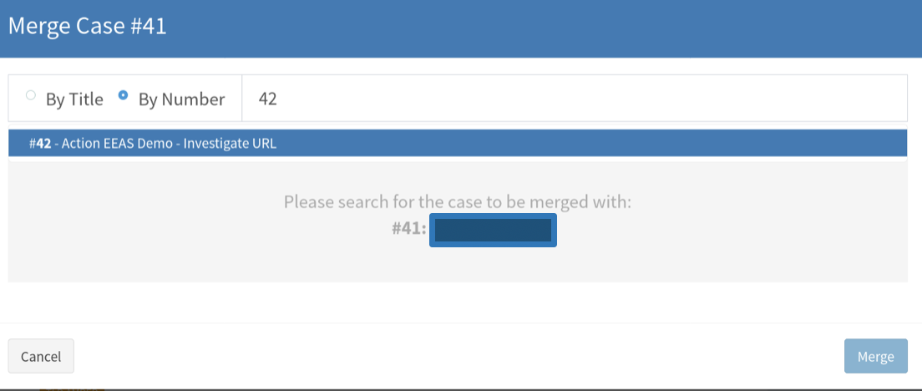
More Case Templates! + merge

Slide 21
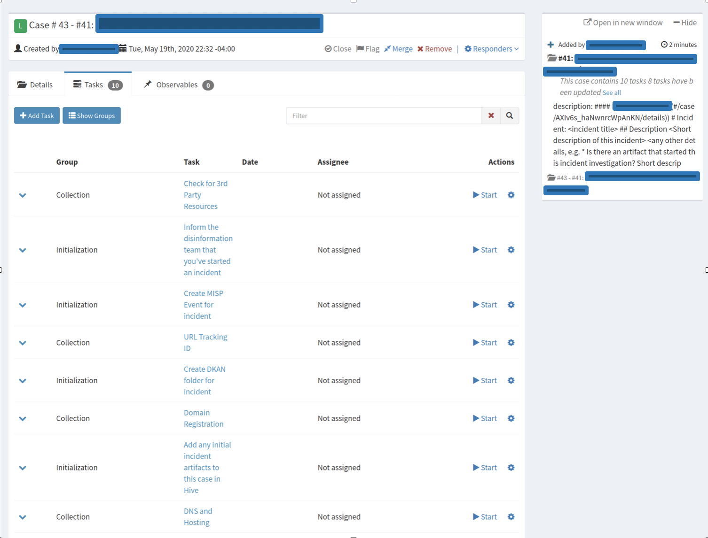
Merged Case
Merged cases have ugly titles but it’s something we can script away

Slide 22
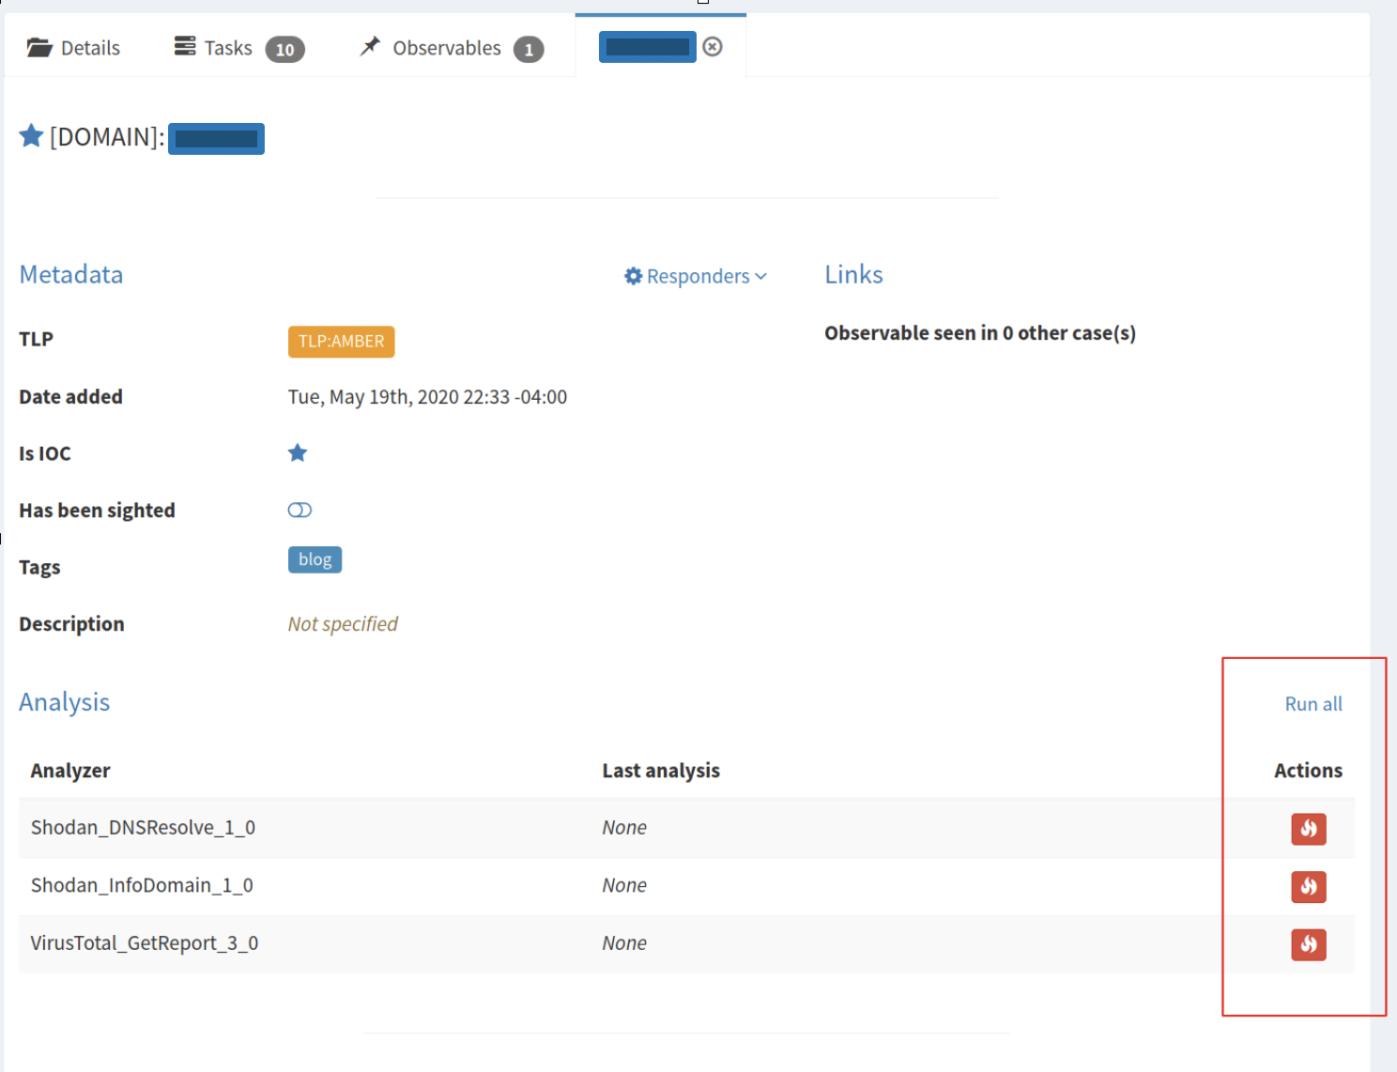
Cortex Analyzers

Slide 23
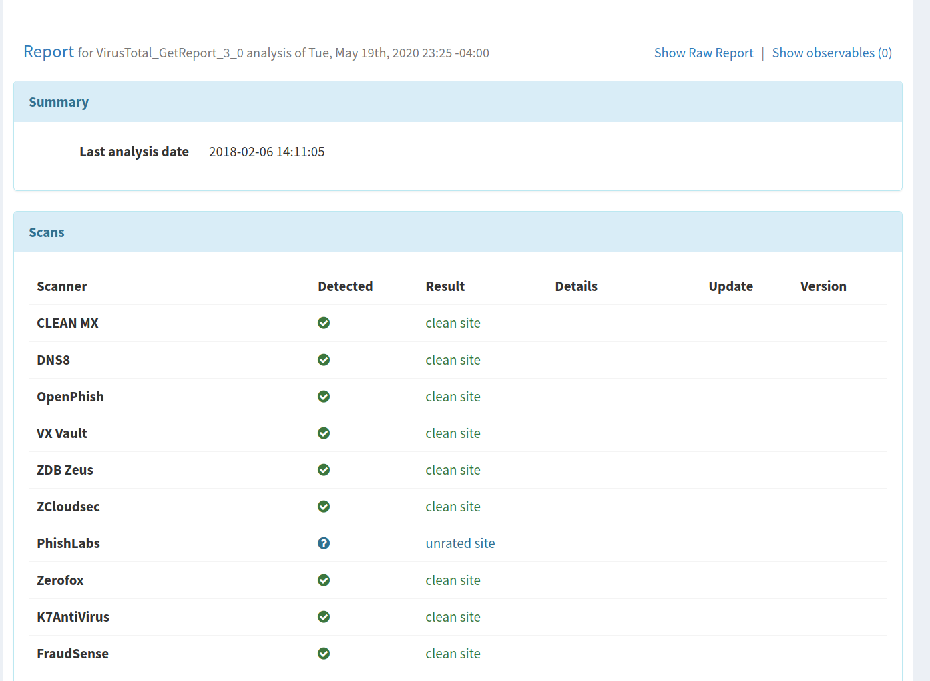
Cortex Analyzers - Reports

Slide 24
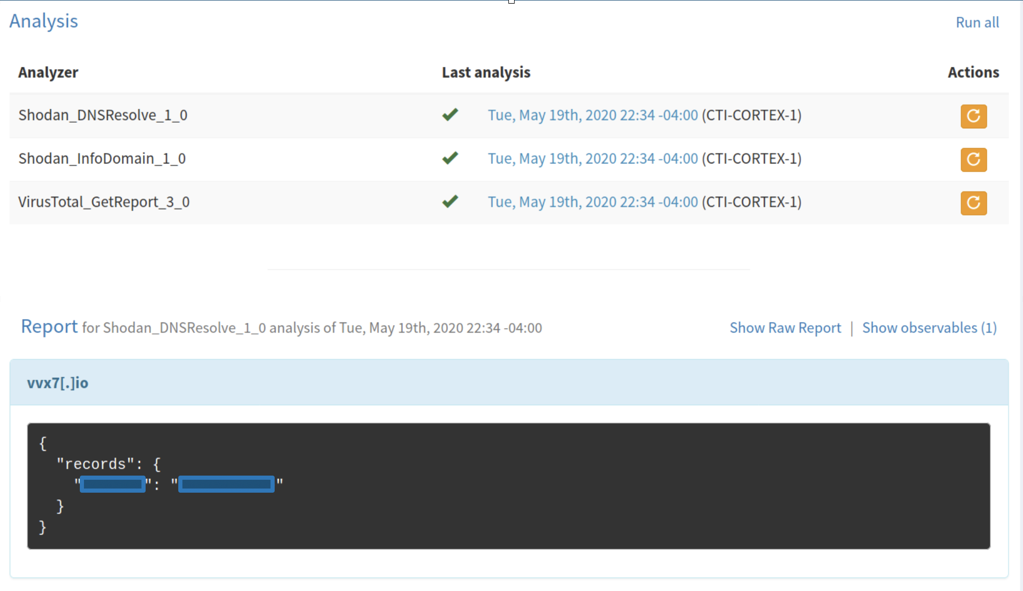
Cortex Analyzers - Reports (JSON)

Slide 25
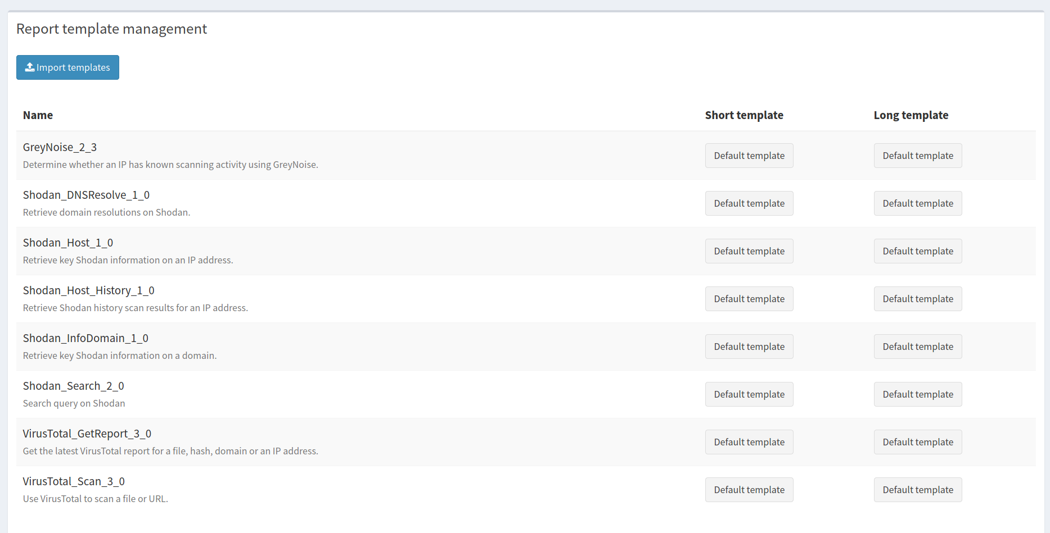
Report Templates

Slide 26
MISP Integration
Import
Tags + Galaxies
Object support in TheHive 4.1+
Export
Tags are not exported*

Slide 27
Cortex Analyzers

